Slide 1
Binary Search Trees
Chapter 11
Presentation for use with the textbook Data Structures and Algorithms in Java, 6th edition, by M. T. Goodrich, R. Tamassia, and M. H. Goldwasser, Wiley, 2014
<
6
2
>
9
1
4
=
8

Slide 2
Sequential search
sequential search: Locates a target value in an array/list by examining each element from start to finish.
How many elements will it need to examine?
Example: Searching the array below for the value 42:
Notice that the array is sorted. Could we take advantage of this?
index | 0 | 1 | 2 | 3 | 4 | 5 | 6 | 7 | 8 | 9 | 10 | 11 | 12 | 13 | 14 | 15 | 16
value | -4 | 2 | 7 | 10 | 15 | 20 | 22 | 25 | 30 | 36 | 42 | 50 | 56 | 68 | 85 | 92 | 103
i

Slide 3
Binary search
binary search: Locates a target value in a sorted array/list by successively eliminating half of the array from consideration.
How many elements will it need to examine?
Example: Searching the array below for the value 42:
index | 0 | 1 | 2 | 3 | 4 | 5 | 6 | 7 | 8 | 9 | 10 | 11 | 12 | 13 | 14 | 15 | 16
value | -4 | 2 | 7 | 10 | 15 | 20 | 22 | 25 | 30 | 36 | 42 | 50 | 56 | 68 | 85 | 92 | 103
min
mid
max
Searches take O(log n) time, using binary search
Inserting a new item takes O(n) time, since in the worst case we have to shift n/2 items to make room for the new item
Removing an item takes O(n) time, since in the worst case we have to shift n/2 items to compact the items after the removal

Slide 4
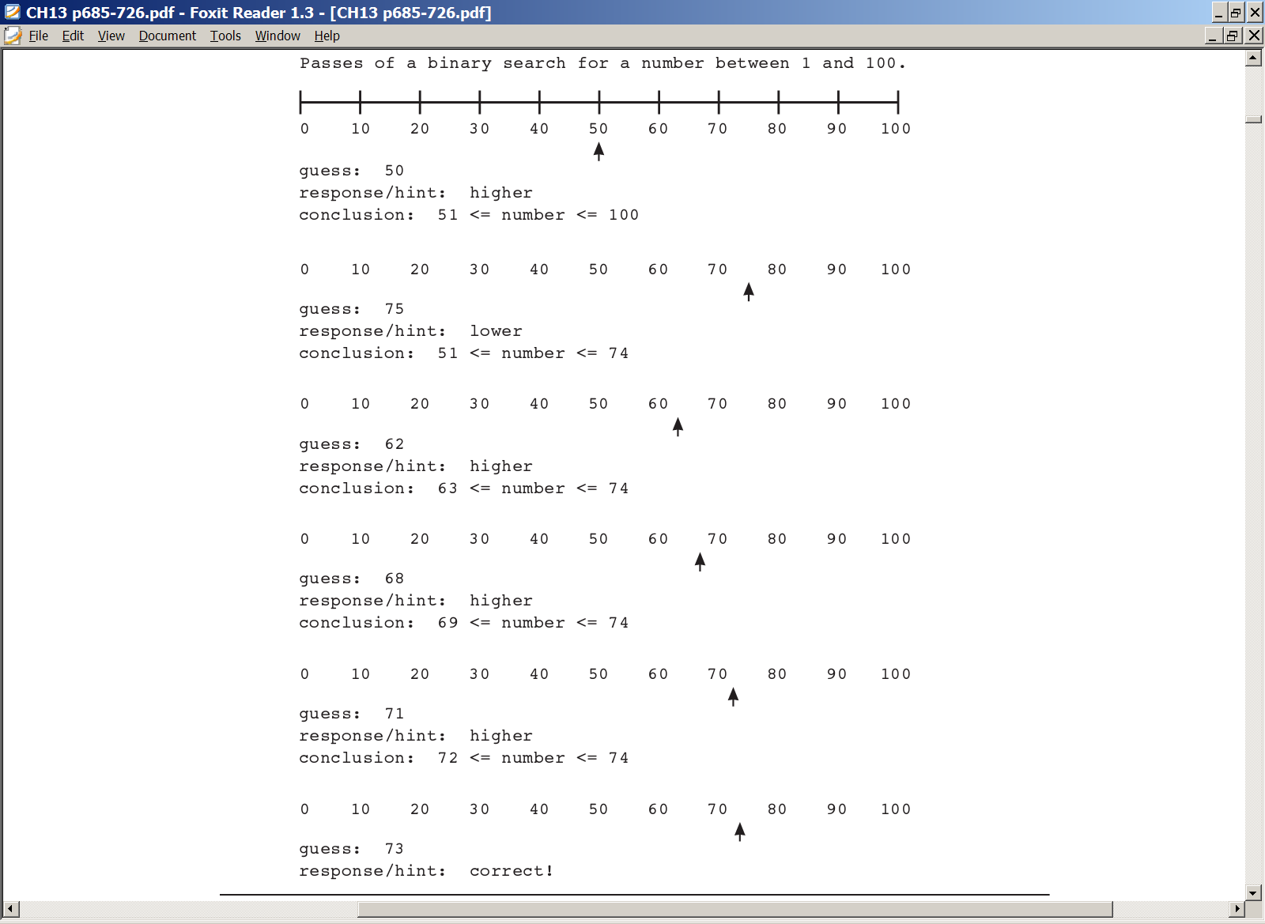
Binary search-Guessing Game
Assume that a computer program generates a random number between 1 and 100 and the user tries to guess it.
After every incorrect guess, the program gives a hint whether the guess is too high or too low.
A poor algorithm is to guess 1, 2, 3, and so on.
A smarter algorithm is to guess the middle number and cut the range in half each time

Slide 5
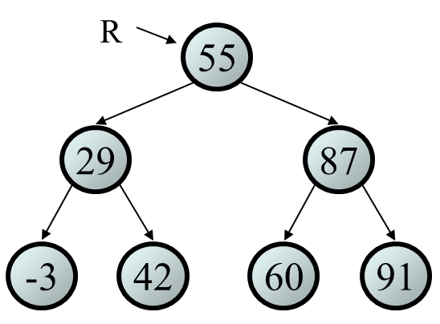
Binary search trees (BST)
BSTs store their elements in sorted order, which is helpful for searching/sorting tasks.
A BST is a binary tree that is either:
empty, or
satisfying the following property:
Let u, v, and w be three nodes such that u is in the left subtree of v and w is in the right subtree of v. We have key(u) ≤ key(v) ≤ key(w)
Example
a root node R, the data is 55:
every element of R's left subtree contains data "less than" 55, the R's data,
every element of R's right subtree contains data "greater than“ 55, the R's data,
R's left and right subtrees are also binary search trees.
v
u
w

Slide 6
Exercise
Which of the trees shown are legal binary search trees?
m
8
42
g
q
5
11
b
k
x
2
7
10
18
7.2
e
4
20
-5
1.9
9.6
18
-1
-7
8.1
21.3

Slide 7
Searching a BST-iterative
Describe an algorithm for searching the tree below for the value 57.
// find node with given key, assumes
//non-empty tree
public boolean contains(int key){
// start at root
Node current = root;
// while no match,
while(current.getElement() != key){
if(key < current.getElement() )
// go left?
current = current.getLeft();
else
// or go right?
current = current.getRight();
// if no child,
if(current == null)
return false;
}
return true; // found it
} // end
Complexity : O(logn)
57 <= 63?
63
57 <= 27?
27
80
57 <= 51?
13
51
70
92
57 <= 58?
82
26
33
58
57 = 57
57
60

Slide 8
Searching a BST-recursive
public class Node { // a node of the tree
//same as in Linked Binary Tree lecture
};
public boolean contains(int k) {
return contains(k, root); // search from virtual root
}
private boolean contains(int k, Node v) {
if (v==null) return false; // key not found
// search left subtree
if (k < v.getElement()) return contains(k, v.getLeft());
// search right subtree
else if (k > v.getElement()) return contains(k, v.getRight());
else return true; // found it here
}

Slide 9
Inorder Traversal of BST
Visit the nodes in ascending order based on key value
Will create a sorted list from a BST if you write the values to an ArrayList
In a binary search tree, the smallest value will be a left-most child
You need to process (e.g. print) this child first
Then you process the parent
Then you process the right child sub-tree of the parent
Then work your way up the left side of the tree doing the same thing
And then work your way down the right side of the tree
27
12
13
26
27
33
51
13
51
12
26
33

Slide 10
Inorder Traversal of BST
Given a list of n numbers or key-value pairs
Insert the keys into a BST
Traverse the BST using in-order traversal
Running time?
Insert the keys into a BST O(n * h)
Traverse the BST using in-order traversal O(n)
Running time? In the worst-case still O(n^2)
27
13
51
12
13
26
27
33
51
12
26
33

Slide 11
Preorder Traversal & Postorder Traversal
Preorder
Process (e.g. print) the node first
Then process the left sub-tree
Then process the right sub-tree
Thus, you process the nodes in the order you visit them, from left sub-trees to right sub-trees
27
13
51
12
26
33
27
13
12
26
51
33
Postorder
Process the node after visiting the sub-trees
For each node:
Traverse the left sub-tree
Traverse the right sub-tree
Process the node
12
26
13
33
51
27

Slide 12
Adding to a BST
Suppose we want to add the value 14 to the BST below.
Where should the new node be added?
Where would we add the value 3?
Where would we add 7?
If the tree is empty, where should a new value be added?
What is the general algorithm?
8
5
11
2
7
10
18
4
20
18

Slide 13
Adding exercise
Draw what a binary search tree would look like if the following values were added to an initially empty tree in this order:
50
20
75
98
80
31
150
39
23
11
77
50
20
75
11
31
98
23
39
80
150
77

Slide 14
Exercise
Add a method add to the BinarySearchTree class that adds a given integer value to the tree. Assume that the elements of the BinarySearchTree constitute a legal binary search tree, and add the new value in the appropriate place to maintain ordering.
tree.add(49);
root
55
29
87
-3
42
60
91
49

Slide 15
add(int value)-iterative
Adding a node
Check if the tree is empty
find the insertion point then link the node to the tree
Example: Adding node with value=12 and tree is empty
public void add(int value){
// create new node
Node newNode = new Node(value);
//tree is empty?
if(root==null)
root= newNode;
else { // root occupied
Node current = root;
...
newNode
12
root =null
root
newNode
12

Slide 16
add(int value)-iterative
while(true) {
if(value < current.getElement() ) { // go left?
if(current.getLeft() == null) { // if end of the line current.setLeft(newNode);
return;
}
current = current.getLeft();
} // end if go left
else { // or go right?
// if end of the right line
if(current.getRight() == null) {
current.setRight(newNode); ;
return;
}
current = current.getRight();
} // end else go right
} // end while
} // end else
size++;
}
Complexity : O(logn)
27
13
51
26
33
58
newNode
12
57
60

Slide 17
add(int value)-Recursive
// post: value is added to overall tree so as to preserve the
// binary search tree property
public void add(int value) {
root = add(root, value);
size++;
}
// post: value is added to given tree so as to preserve the
// binary search tree property
private Node add(Node rt, int value) {
if (rt == null) {
rt = new Node(value);
} else if (value <= rt.getElement()) {
rt.setLeft(add(rt.getLeft(), value));
} else {
rt.setRight(add(rt.getRight(), value));
}
return rt;
}

Slide 18
Searching BSTs
The BSTs below contain the same elements.
What orders are "better" for searching?
root
19
root
root
7
14
9
11
4
19
9
6
14
6
14
7
4
7
11
19
9
6
11
4
What is the worst-case height of the tree?
Could be O(n)!

Slide 19
Trees and balance
balanced tree: One whose subtrees differ in height by at most 1 and are themselves balanced.
A balanced tree of N nodes has a height of ~ log₂ N.
A very unbalanced tree can have a height close to N.
The runtime of adding to / searching a BST is closely related to height.
overall root
9
6
14
4
8
19
height = 4
(balanced)
7

Slide 20
Exercise
Add a method getMin to the class that returns the node with minimum integer value from the tree. Assume that the elements constitute a legal binary search tree.
Node min = tree.getMin(); // -3
Keep going to the left till you hit a leaf O(h)
getMax? Finding the maximum:
Keep going to the right till you hit a leaf O(h)
Finding the next larger after a given k
Find k then get right child O(h)
root
55
29
87
-3
42
60
91

Slide 21
Solution getMin()
// Returns the node with minimum value from this BST.
// Throws a NoSuchElementException if the tree is empty.
public Node getMin() {
if (root == null) throw new NoSuchElementException();
return getMin(root);
}
//recursive
private Node getMin(Node rt) {
if (rt.getLeft() == null)
return rt;
else
return getMin(rt.getLeft());
}
//iterative version
public Node getMinimumNode(Node curr){
while (curr.getLeft() != null)
curr = curr.getLeft();
return curr;
}
root
55
29
87
-3
42
60
91

Slide 22
Node removal
Add a method remove that removes a given integer value from the tree, if present. Assume that the elements of the tree constitute a legal binary search tree, and remove the value in such a way as to maintain ordering.
tree.remove(73);
tree.remove(29);
tree.remove(87);
tree.remove(55);
overall root
55
29
87
42
60
91
36
73

Slide 23
Cases for removal 1
1. a leaf: replace with null
2. a node with a left child only: replace with left child
3. a node with a right child only: replace with right child
overall root
overall root
overall root
overall root
55
55
29
42
29
29
42
tree.remove(29);
-3
42
42
tree.remove(-3);
tree.remove(55);

Slide 24
Cases for removal 2
4. a node with both children: replace with min from right
overall root
overall root
55
60
tree.remove(55);
29
87
29
87
-3
42
60
91
-3
42
91

Slide 25
Deleting Nodes
To delete a node (without destroying the order in the tree):
To delete a leaf node (no children): disconnect it.
To delete a node with one child: bypass the node and directly connect its parent to the child.
To delete a node with two children:
find the smallest node in its right subtree (or the largest node in its left subtree),
use it to replace the node to be deleted,
and then delete the smallest (or largest) node itself.
5
2
7
1
3
6
8
4

Slide 26
Deleting Nodes
To delete a node (without destroying the order in the tree):
To delete a leaf node (no children): disconnect it.
To delete a node with one child: bypass the node and directly connect its parent to the child.
To delete a node with two children:
find the smallest node in its right subtree (or the largest node in its left subtree),
use it to replace the node to be deleted,
and then delete the smallest (or largest) node itself.
5
2
7
1
3
6
8
4

Slide 27
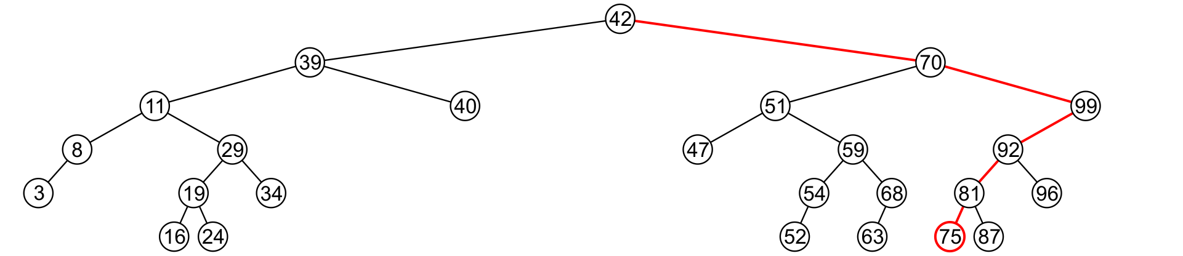
Node removal
A leaf node simply must be removed and the appropriate member variable of the parent is set to NULL
Consider removing 75

Slide 28
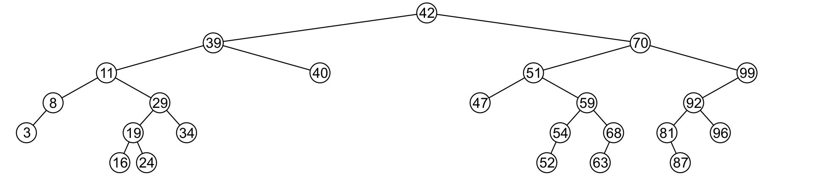
Erase
The node is deleted and left of 81 is set to NULL

Slide 29
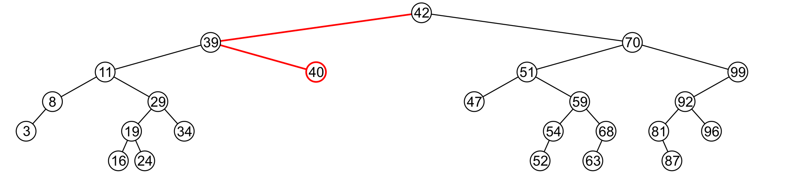
Node removal
Erasing the node containing 40 is similar

Slide 30
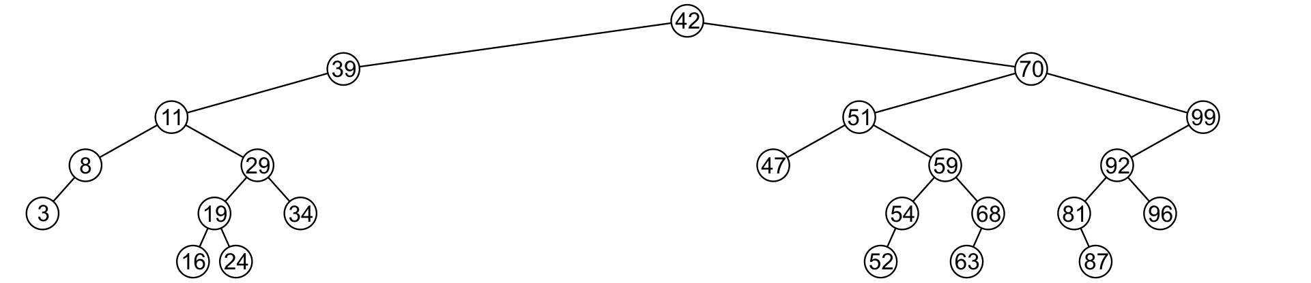
Node removal
The node is deleted and right of 39 is set to NULL

Slide 31
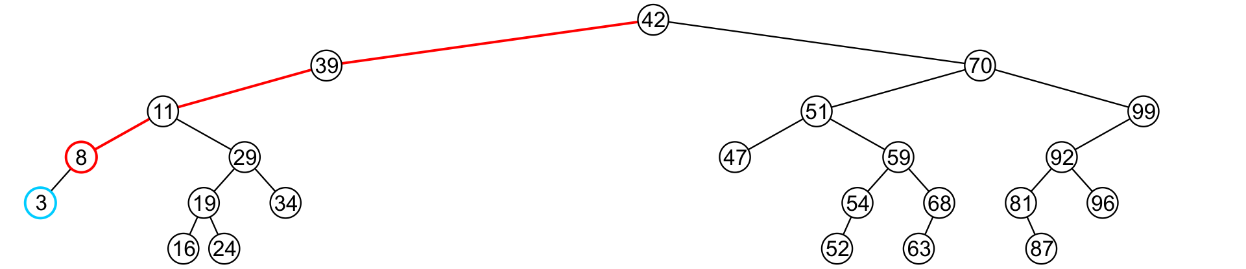
Node removal
If a node has only one child, we can simply promote the sub-tree associated with the child
Consider removing 8 which has one left child

Slide 32
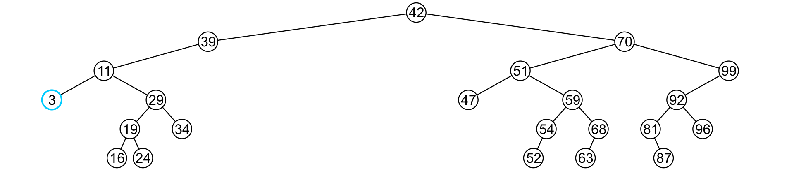
Node removal
The node 8 is deleted and the tree of 11 is updated to point to 3

Slide 33
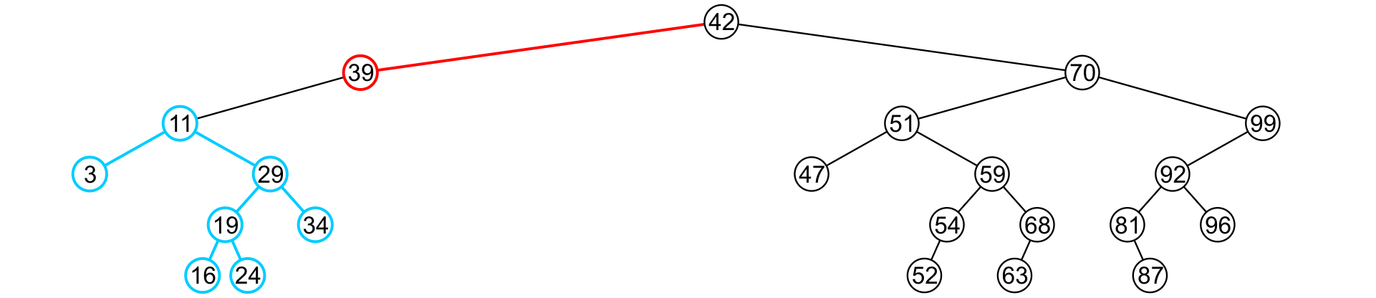
Node removal
There is no difference in promoting a single node or a sub-tree
To remove 39, it has a single child 11

Slide 34
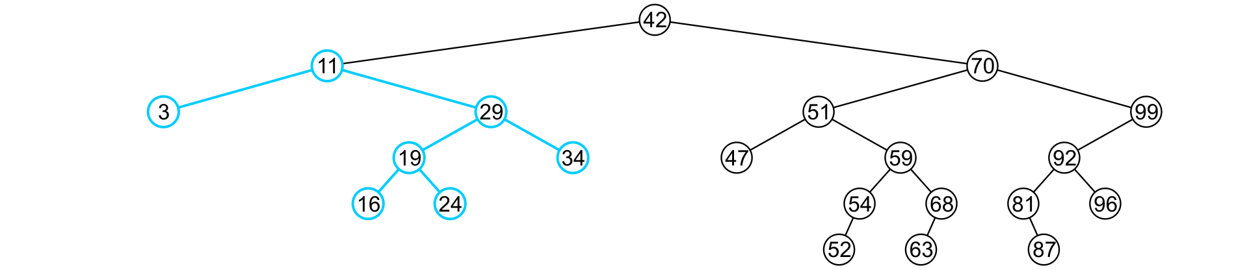
Node removal
The node containing 39 is deleted and left of 42 is updated to point to 11
Notice that order is still maintained

Slide 35
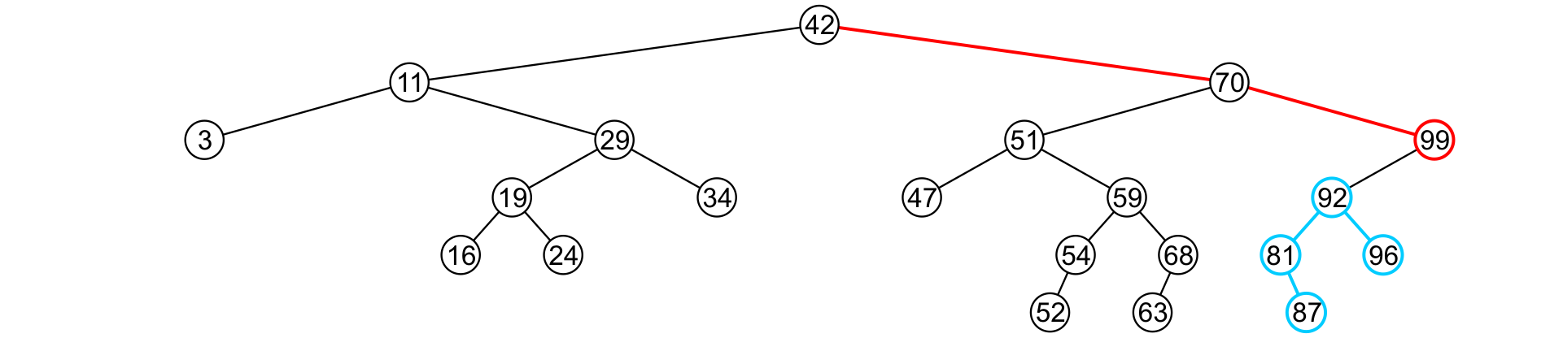
Node removal
Consider erasing the node containing 99

Slide 36
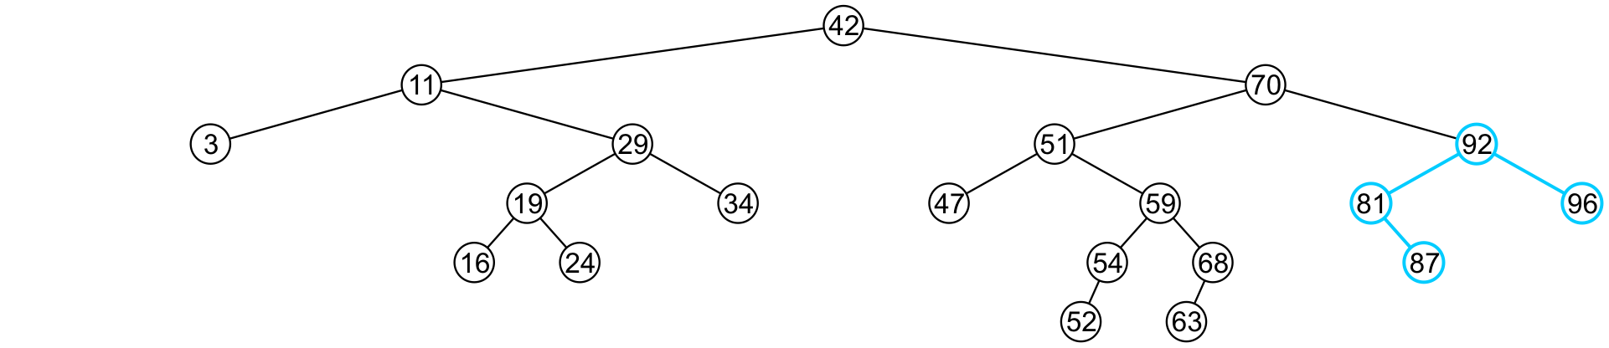
Node removal
The node is deleted and the left sub-tree is promoted:
The member variable right of 70 is set to point to 92
Again, the order of the tree is maintained

Slide 37
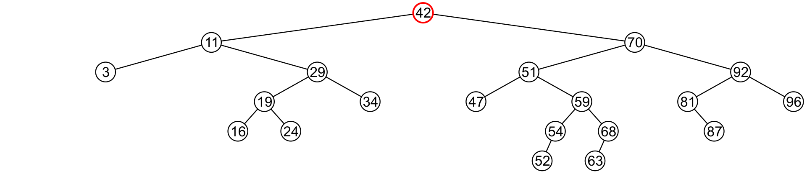
Node removal
Finally, we will consider the problem of erasing a full node, e.g., 42
We will perform two operations:
Replace 42 with the minimum object in the right sub-tree
Erase that object from the right sub-tree

Slide 38
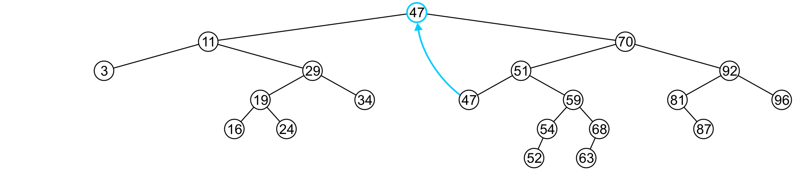
Node removal
In this case, we replace 42 with 47
We temporarily have two copies of 47 in the tree

Slide 39
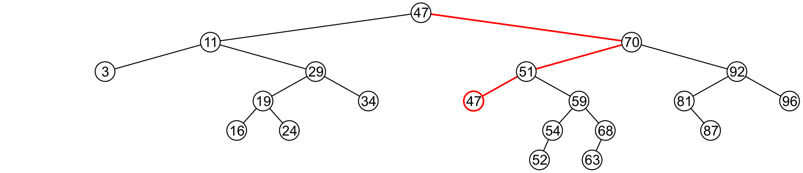
Node removal
We now recursively erase 47 from the right sub-tree
We note that 47 is a leaf node in the right sub-tree

Slide 40
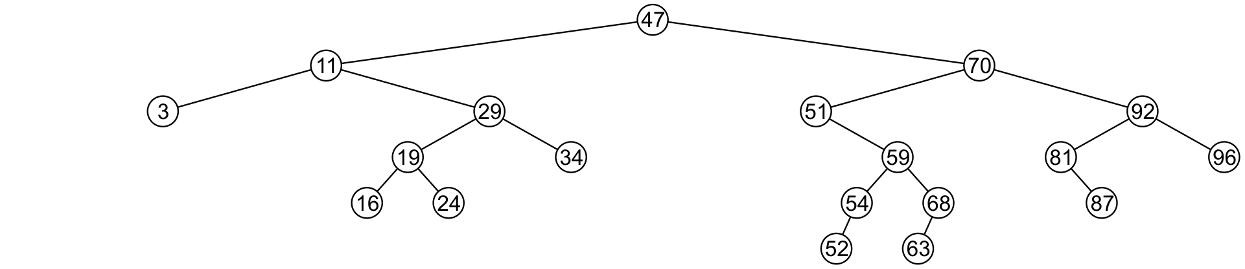
Node removal
Leaf nodes are simply removed and left of 51 is set to NULL
Notice that the tree is still sorted:
47 was the least object in the right sub-tree

Slide 41
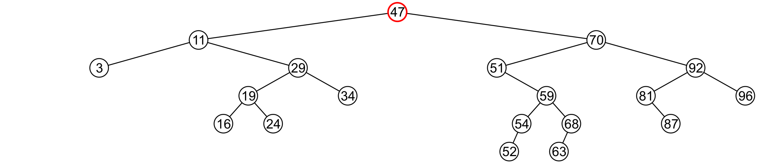
Node removal
Suppose we want to erase the root 47 again:
We must copy the minimum of the right sub-tree
We could promote the maximum object in the left sub-tree and achieve similar results

Slide 42
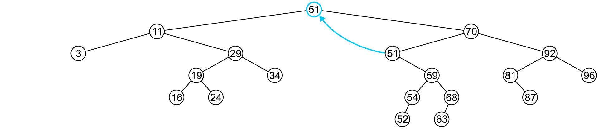
Node removal
We copy 51 from the right sub-tree

Slide 43
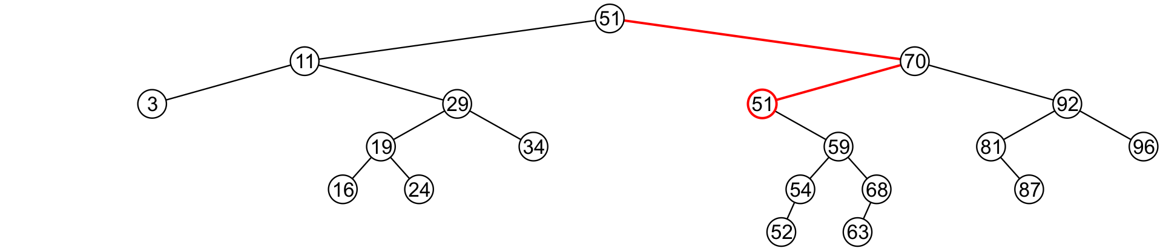
Node removal
We must proceed by delete 51 from the right sub-tree

Slide 44
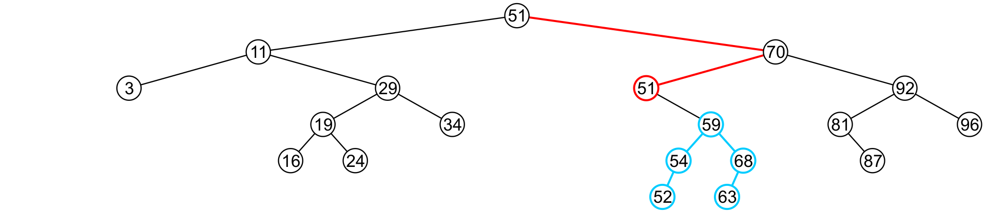
Node removal
In this case, the node storing 51 has just a single child

Slide 45
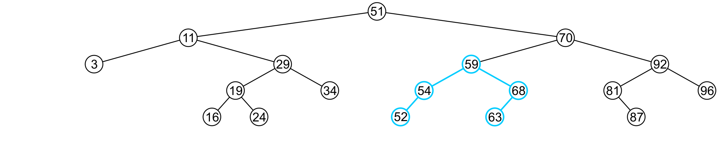
Node removal
We delete the node containing 51 and assign the member variable left of 70 to point to 59

Slide 46
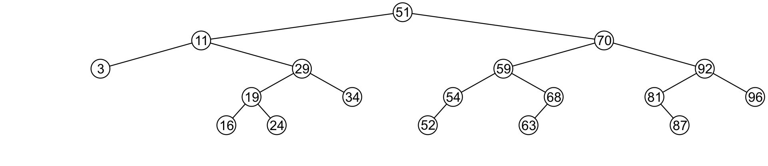
Node removal
Note that after seven removals, the remaining tree is still correctly sorted

Slide 47


Node removal
In the two examples of removing a full node, we promoted:
A node with no children
A node with right child
Is it possible, in removing a full node, to promote a child with two children?

Slide 48
Node removal
Recall that we promoted the minimum value in the right sub-tree
If that node had a left sub-tree, that sub-tree would contain a smaller value

Slide 49
Delete Nodes – find the node -Iterative
public boolean remove(int key) { // delete node with given key
Node current = root;
Node parent = null;
boolean isLeftChild = true;
while(current != null && current.getElement() != key) {
// search for node
parent = current;
if(key < current.getElement() ){
// go left?
isLeftChild = true;
current = current.getLeft();
}
else{ // or go right?
isLeftChild = false;
current = current.getRight();
}
if(current == null) // end of the line,
return false; // didn't find it
} // end while, found node to delete
4
parent
2
5
current
1
3

Slide 50
Delete Nodes – nochildren
// if no children, simply delete it
if(current.getLeft()==null && current.getRight()==null){
if(current == root) // if root,
root = null; // tree is empty
else
if(isLeftChild) // disconnect from parent
parent.setLeft(null);
else
parent.setRight(null);
}
parent
4
parent
4
current
2
5
2
5
delete
1
3
1
3

Slide 51
Delete Nodes – One child
parent
…
// if no right child, replace with left subtree
else if(current.getRight()==null)
if(current == root)
root = current.getLeft();
else if(isLeftChild)
parent.setLeft(current.getLeft());
else
parent.setRight(current.getLeft());
else if(current.getLeft()==null)
if(current == root)
root = current.getRight();
else if(isLeftChild)
parent.setLeft(current.getRight());
else
parent.setRight(current.getRight());
…
4
current
2
5
3
parent
4
delete
2
5
3

Slide 52
Deleting Nodes – Multiple children
parent
6
current
Assuming you want to preserve the sort order, deletion is not straight forward
Replace the deleted node with a node that preserves the sort order – the inorder successor node for inorder trees
The successor node will be in the right subtree, left most node
2
7
1
4
8
3
5
successor

Slide 53
Deleting Nodes – Multiple children
else (
//get successor of node to delete (current)
Node successor = getMin(current.getRight());
int val = successor.getElement();
remove(val);
current.setElement(val);
size++;
} // end else two children
size--;
} // end of remove
parent
current
6
2
7
1
4
8
successor
3
5
parent
6
3
7
1
4
8
5

Slide 54
Deleting Nodes – Recursive
public void remove(int value) {
root = remove(root, value);
}
private Node remove(Node rt, int value) {
if (rt == null) {
return null;
} else if (rt.getElement() > value) {
rt.setLeft(remove(rt.getLeft(), value));
} else if (rt.getElement() < value) {
rt.setRight(remove(rt.getRight(), value));
} else { // root.data == value; remove this node
size--;
if (rt.getRight() == null) {
return rt.getLeft(); // no R child; replace w/ L
} else if (rt.getLeft() == null) {
return rt.getRight(); // no L child; replace w/ R
} else {
// both children; replace w/ min from R
rt.setElement(getMin(rt.getRight()).getElement());
size++;
rt.setRight(remove(rt.getRight(), rt.getElement()));
}
}
return rt;
}

